Slide 1

INFO 6150 Web Design and User Experience Engineering
Menu Masters

Slide 2
Creators:
Sushmitha Prathap 002774283
Aditya Saurav Vijay 002785945
Nishith 002745202
Suprith Kambadahalli Prakash 002784202

Slide 3
Summary:
We are developing a web application that simplifies the process for college students and young professionals to come up with meal ideas. Help them find recipes with the ingredients they have available. Additionally present the recipes keeping health as the major point of view. This will essentially reduce the amount of time that is spent on thinking about what can made out of the ingredients in hand. This will help students and professionals focus on being more productive.
Enables users to track the calories being consumed and also make them more inclined towards eating healthy on a daily basis.
Users can also explore recipes from different parts of the world or within their locality and try out new recipes.
This user requirements specification (URS) documents the user requirements for the development of the app

Slide 4



Tech Stack
React
Redux
Express
Node
Mongo DB
Session Storage
Material UI

Slide 5

Features:
Home Page : Consists of all the functionalities.
Explore : Contains the list of ingredients, when chosen would recommend the closest recipe based on the ingredients.
Blogs: Place for food enthusiastic to interact and share recipes.
Tracker : For the fitness enthusiastic to keep a track on calories.
Inventory : Keeping track of the individual's pantry.
Grocery List : Missing pantry items
Recipe : List of recipes added by the user.

Slide 6
Contributions:
Sushmitha Prathap Nishith > Landing Page >Login And Register > Home Page >Recipe Functionality > Inventory Functionality >Explore Page
Aditya Saurav Vijay Suprith Kambadahalli Prakash > Blogs Functionality > Calorie Tracking > Email Functionality > Meals Functionality > View and update user details

Slide 7
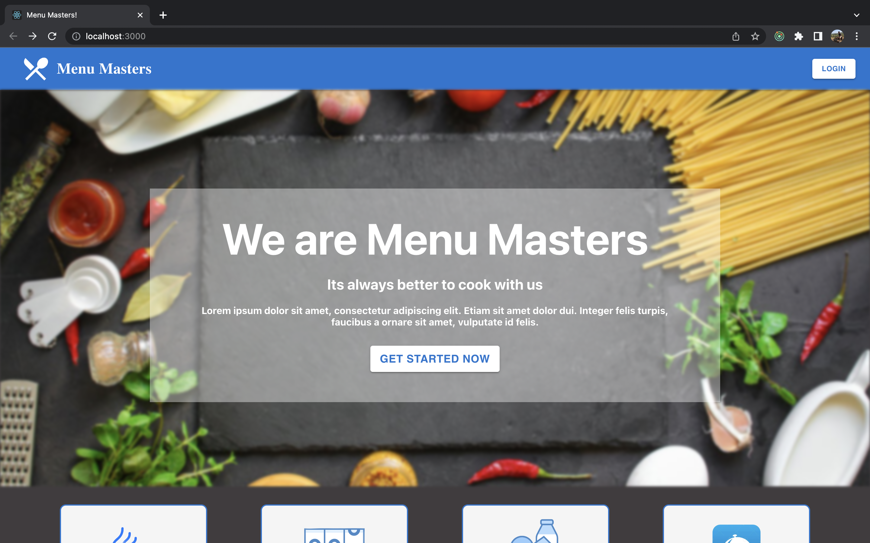
Landing Page

Slide 8
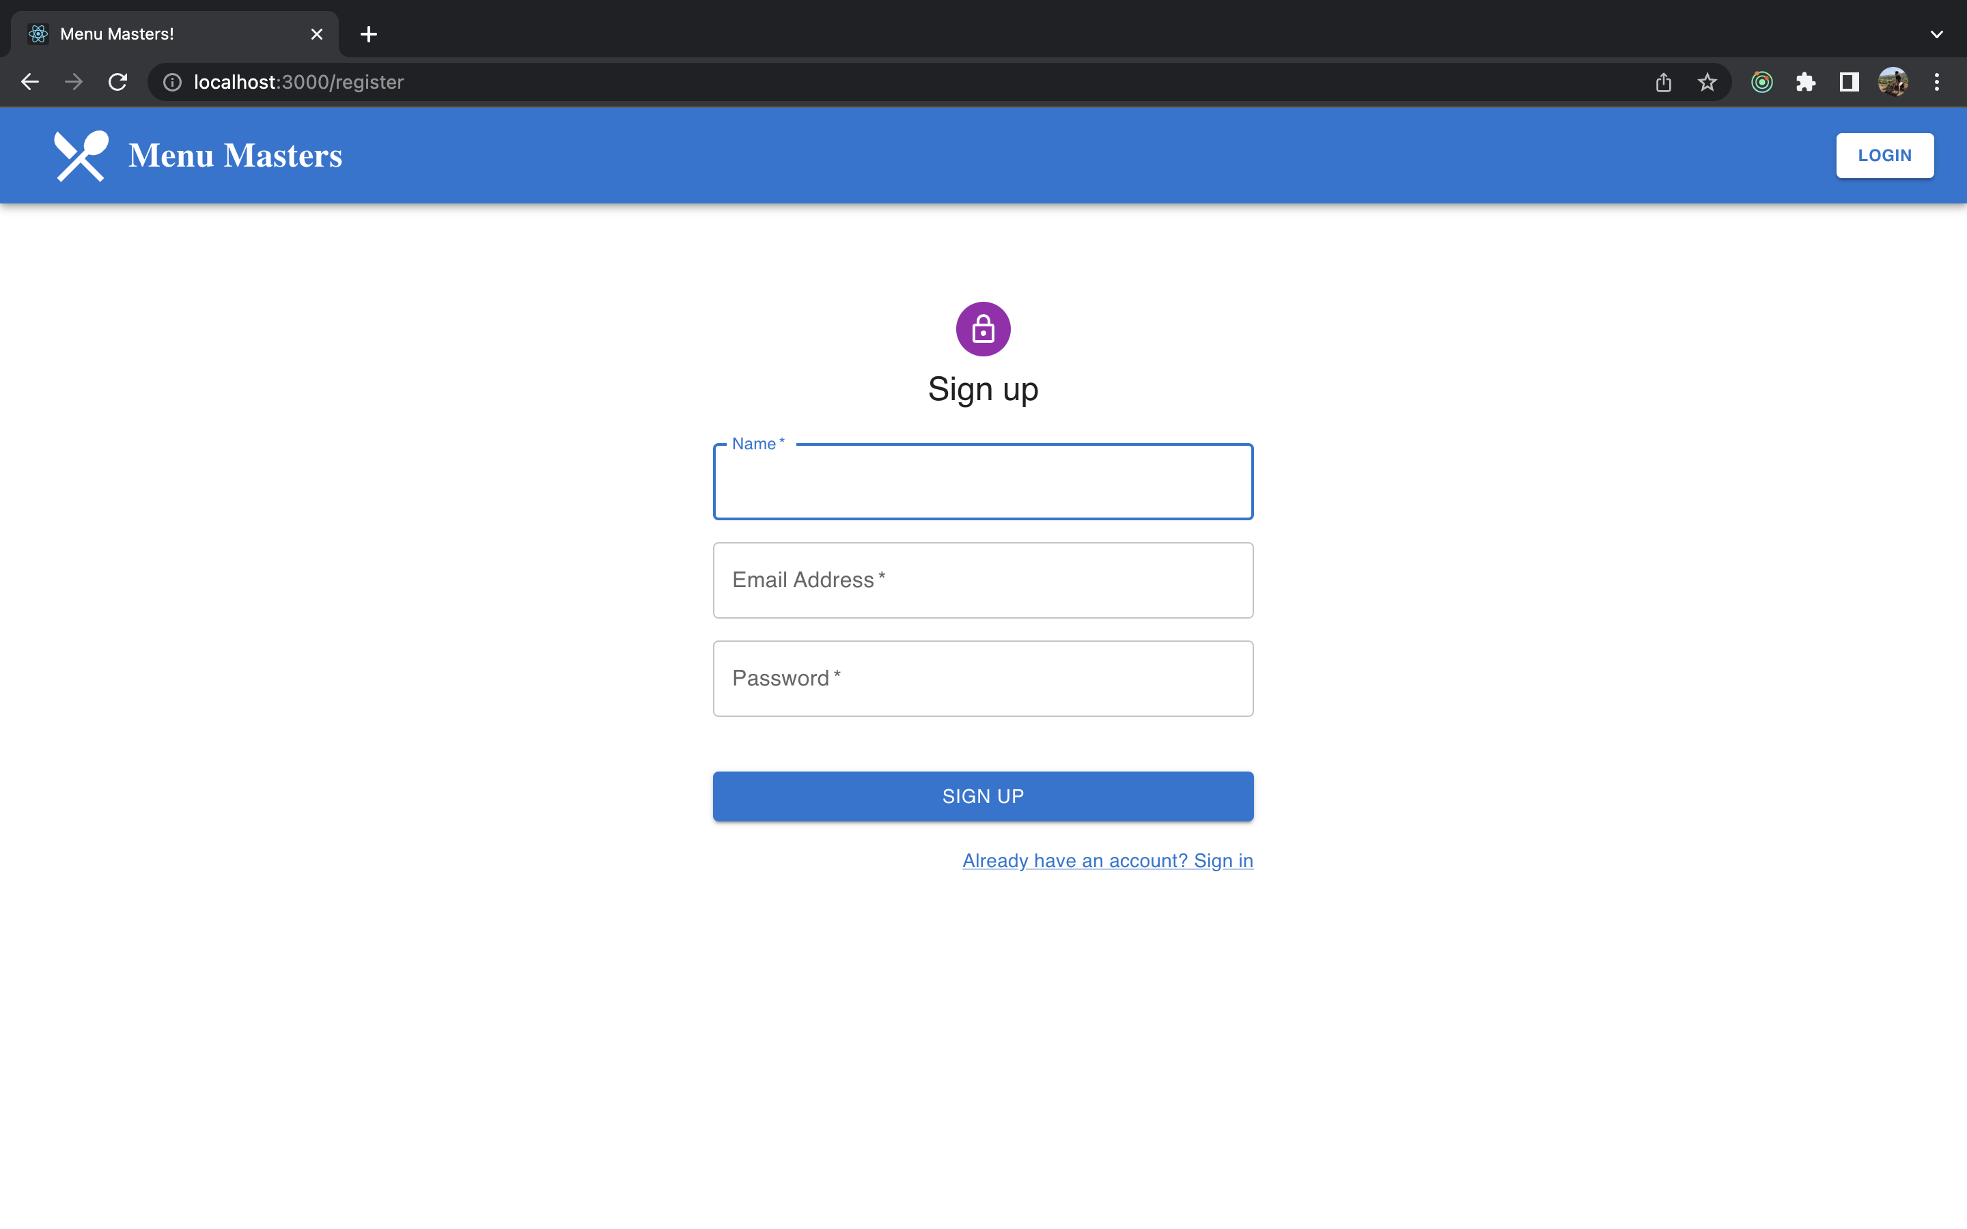
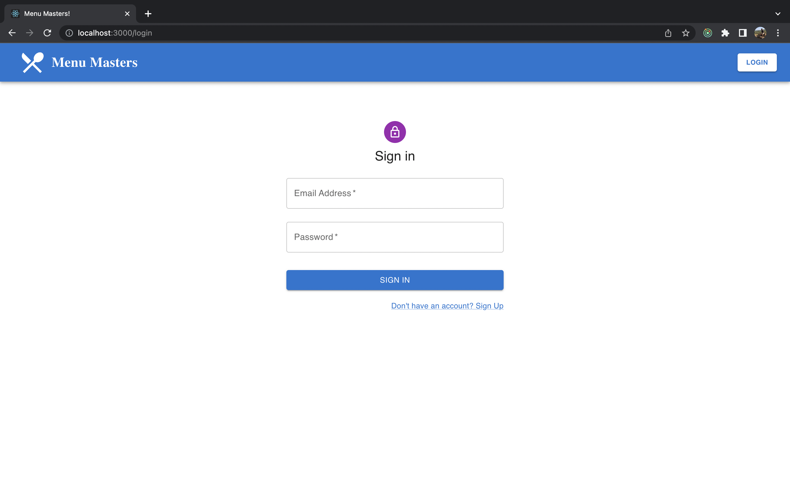
Register / Login

Slide 9
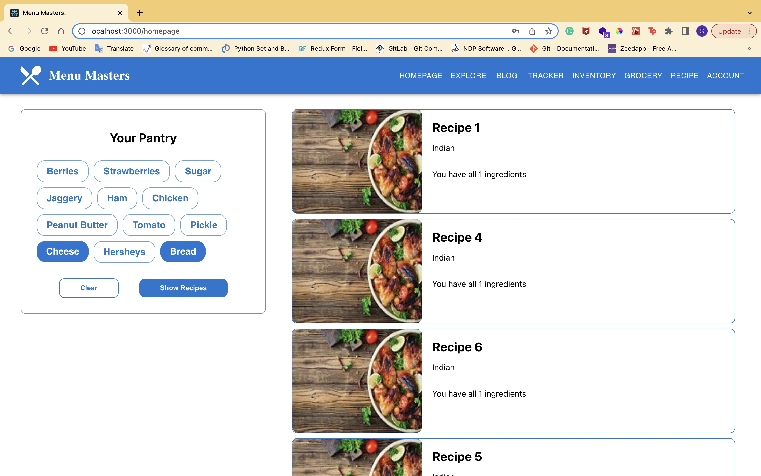
Home Page

Slide 10
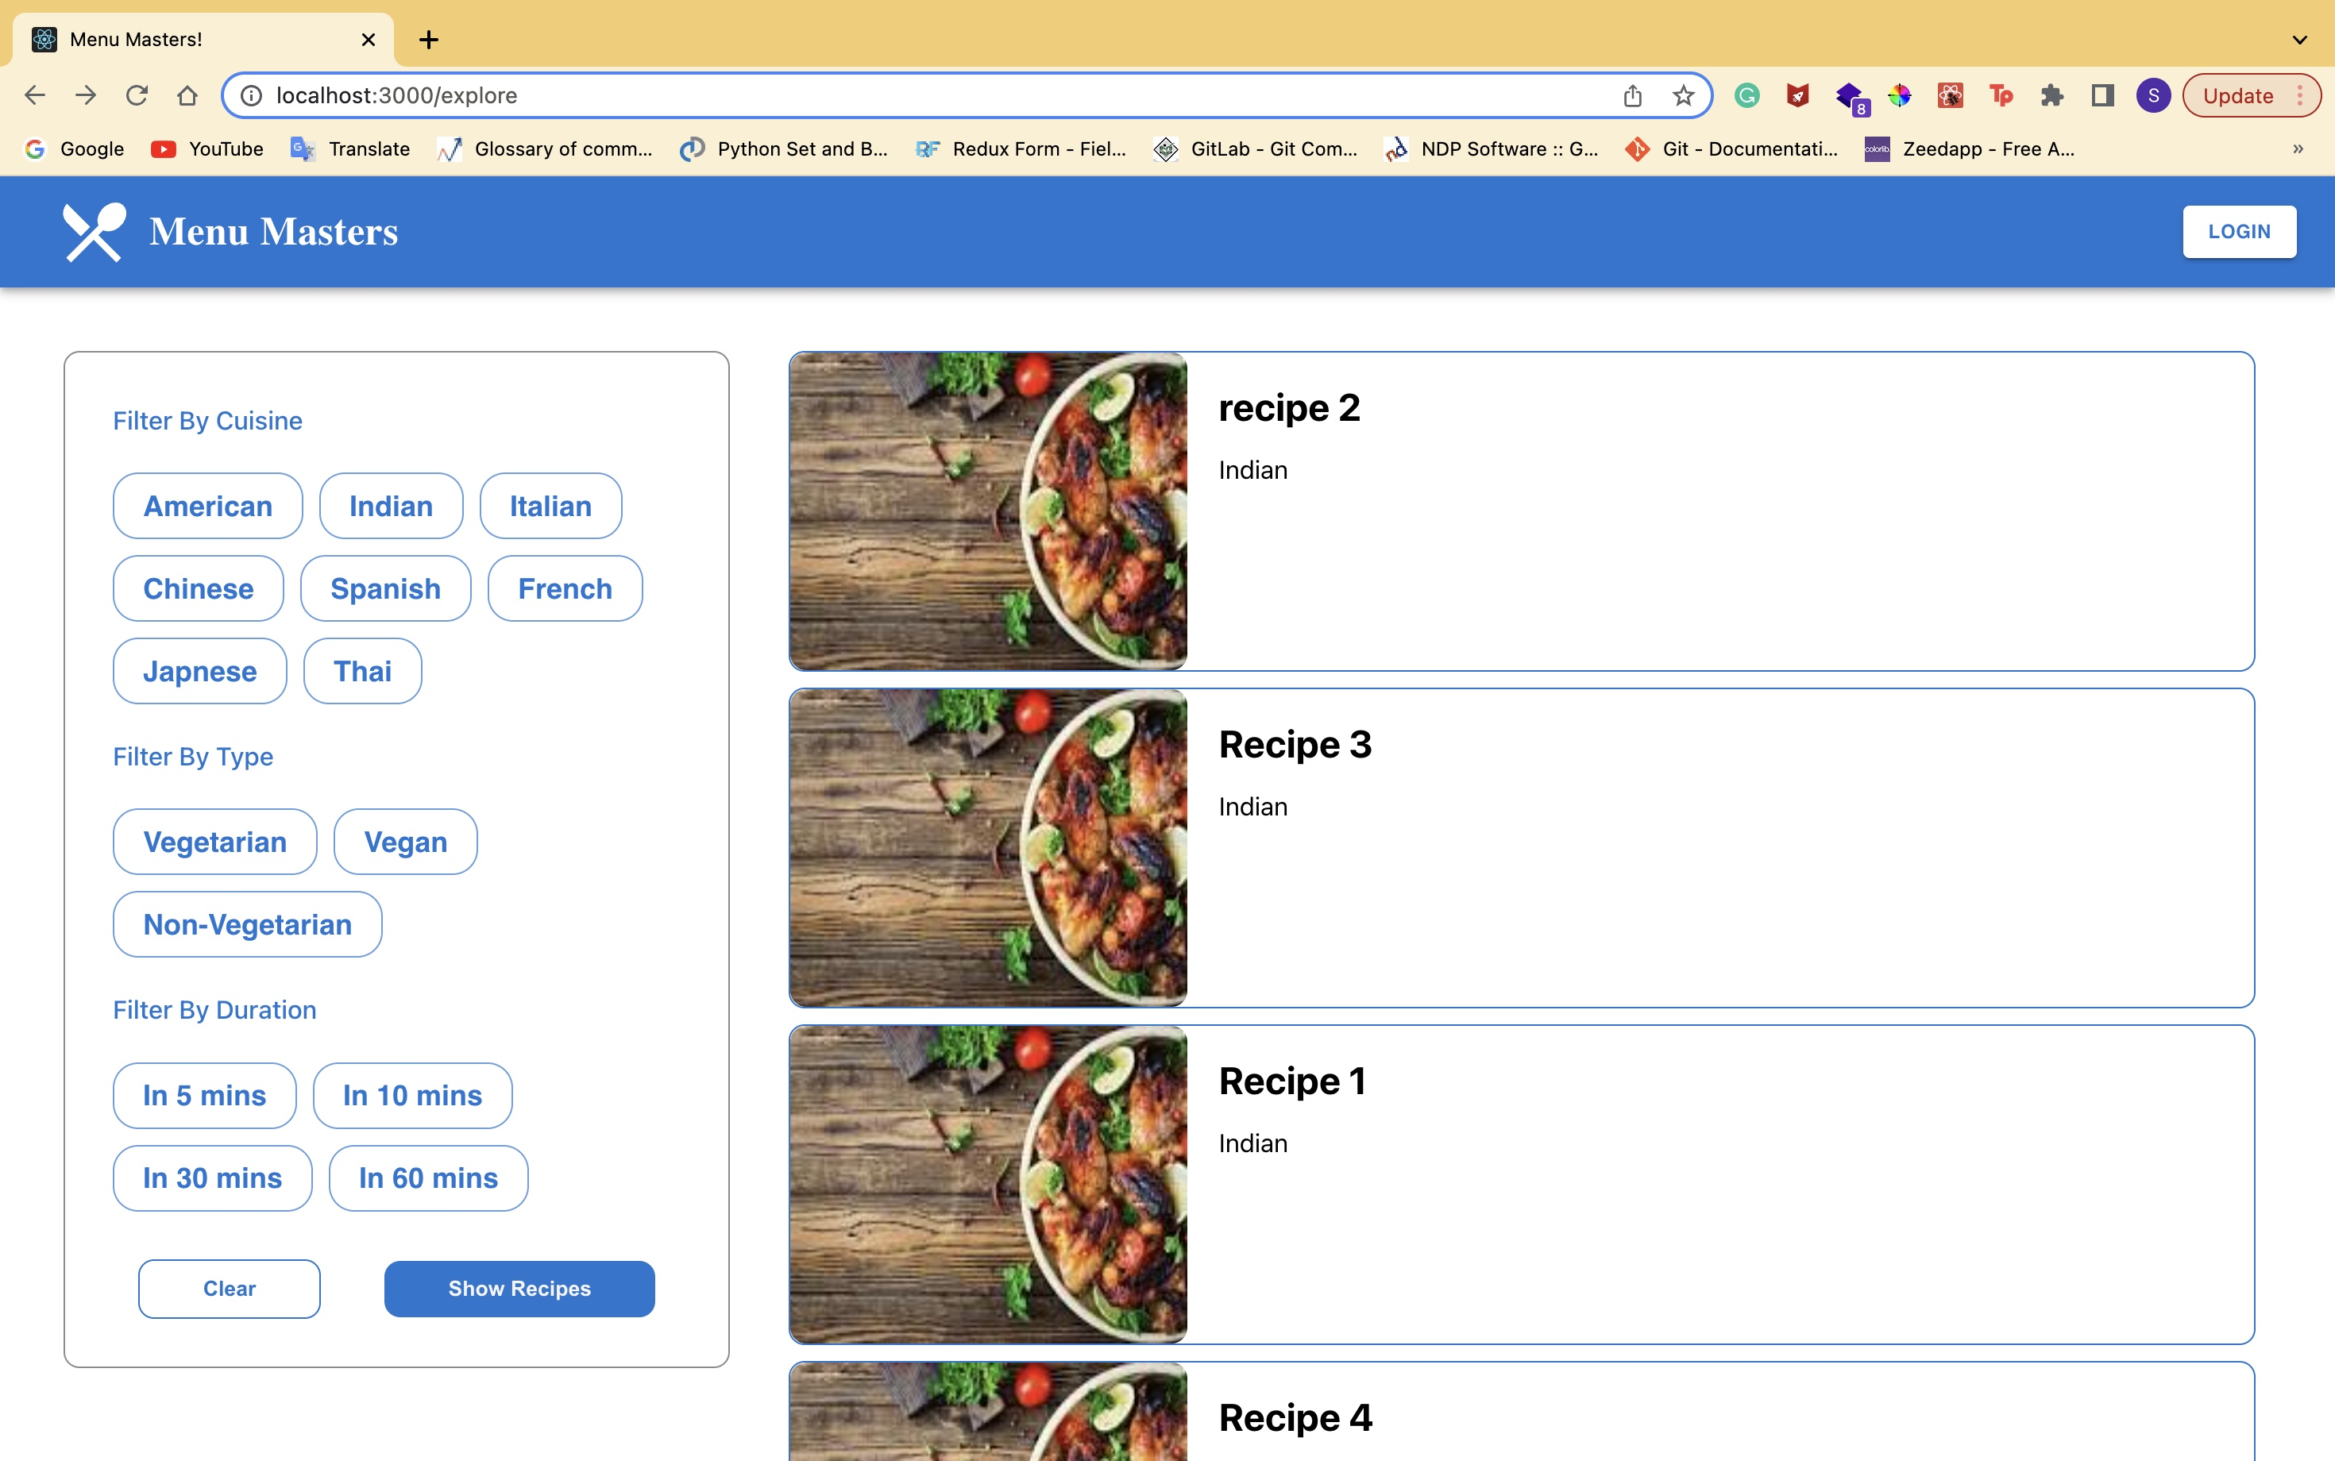
Explore

Slide 11
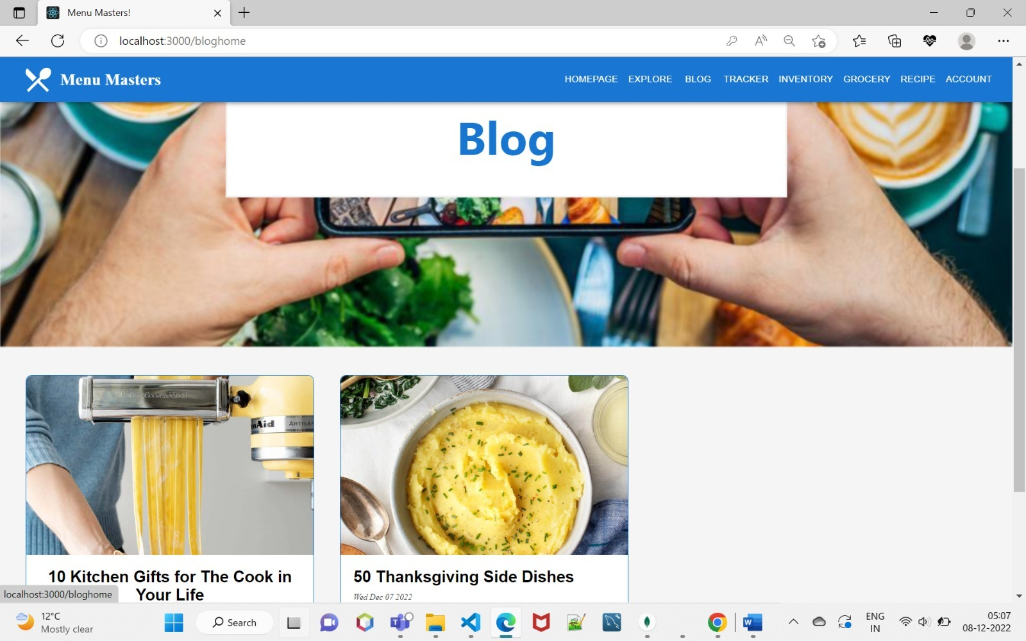
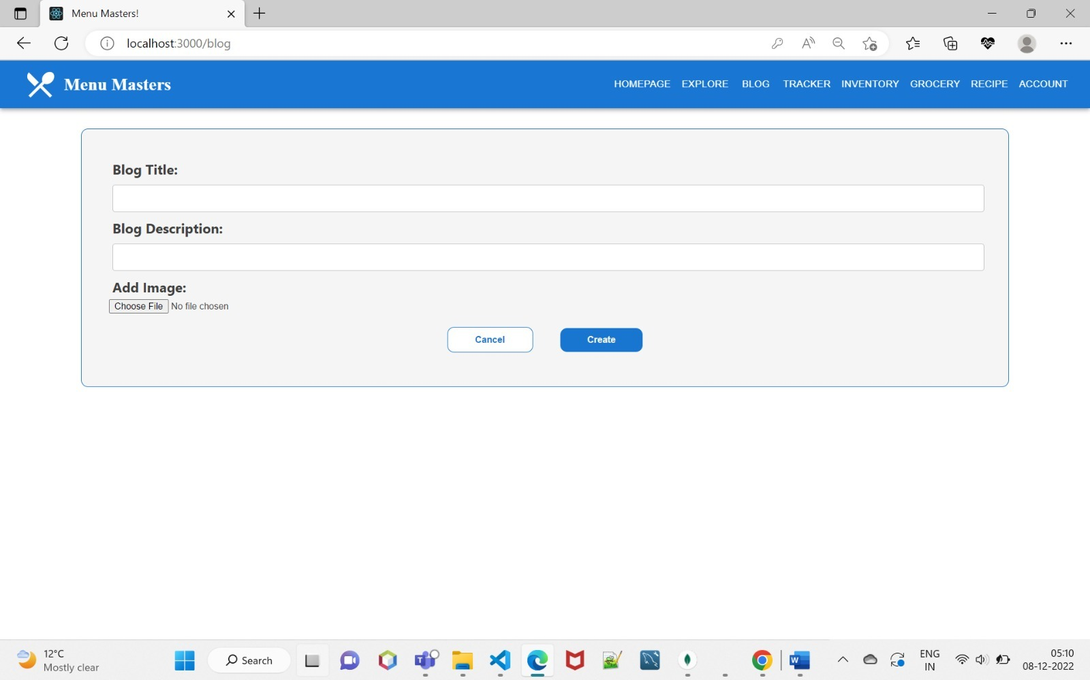
Blogs

Slide 12
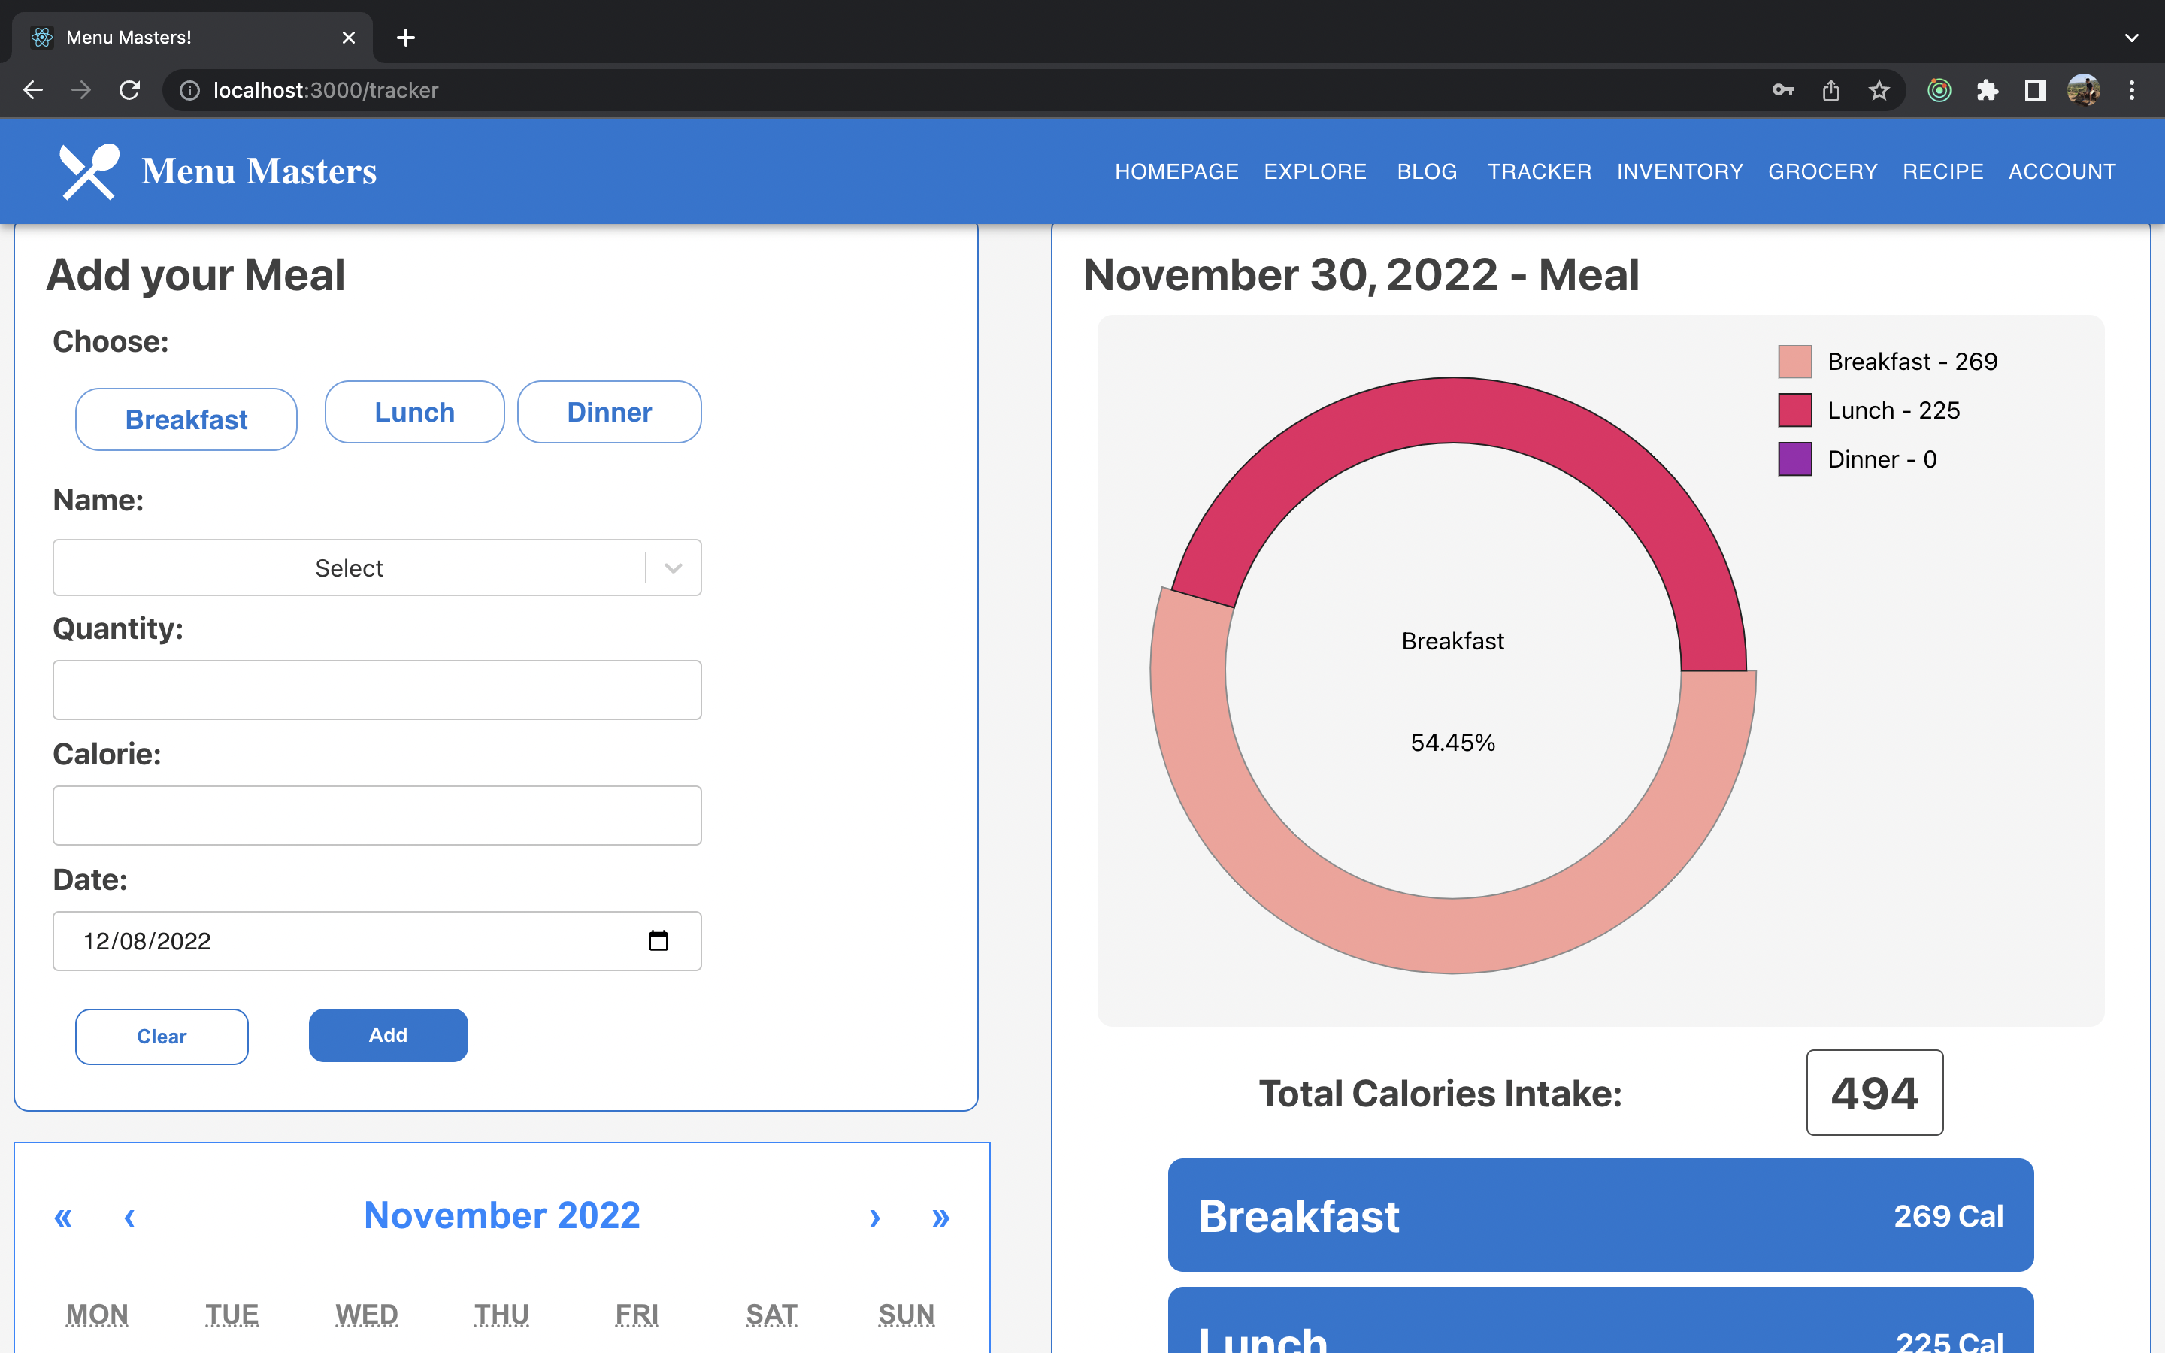
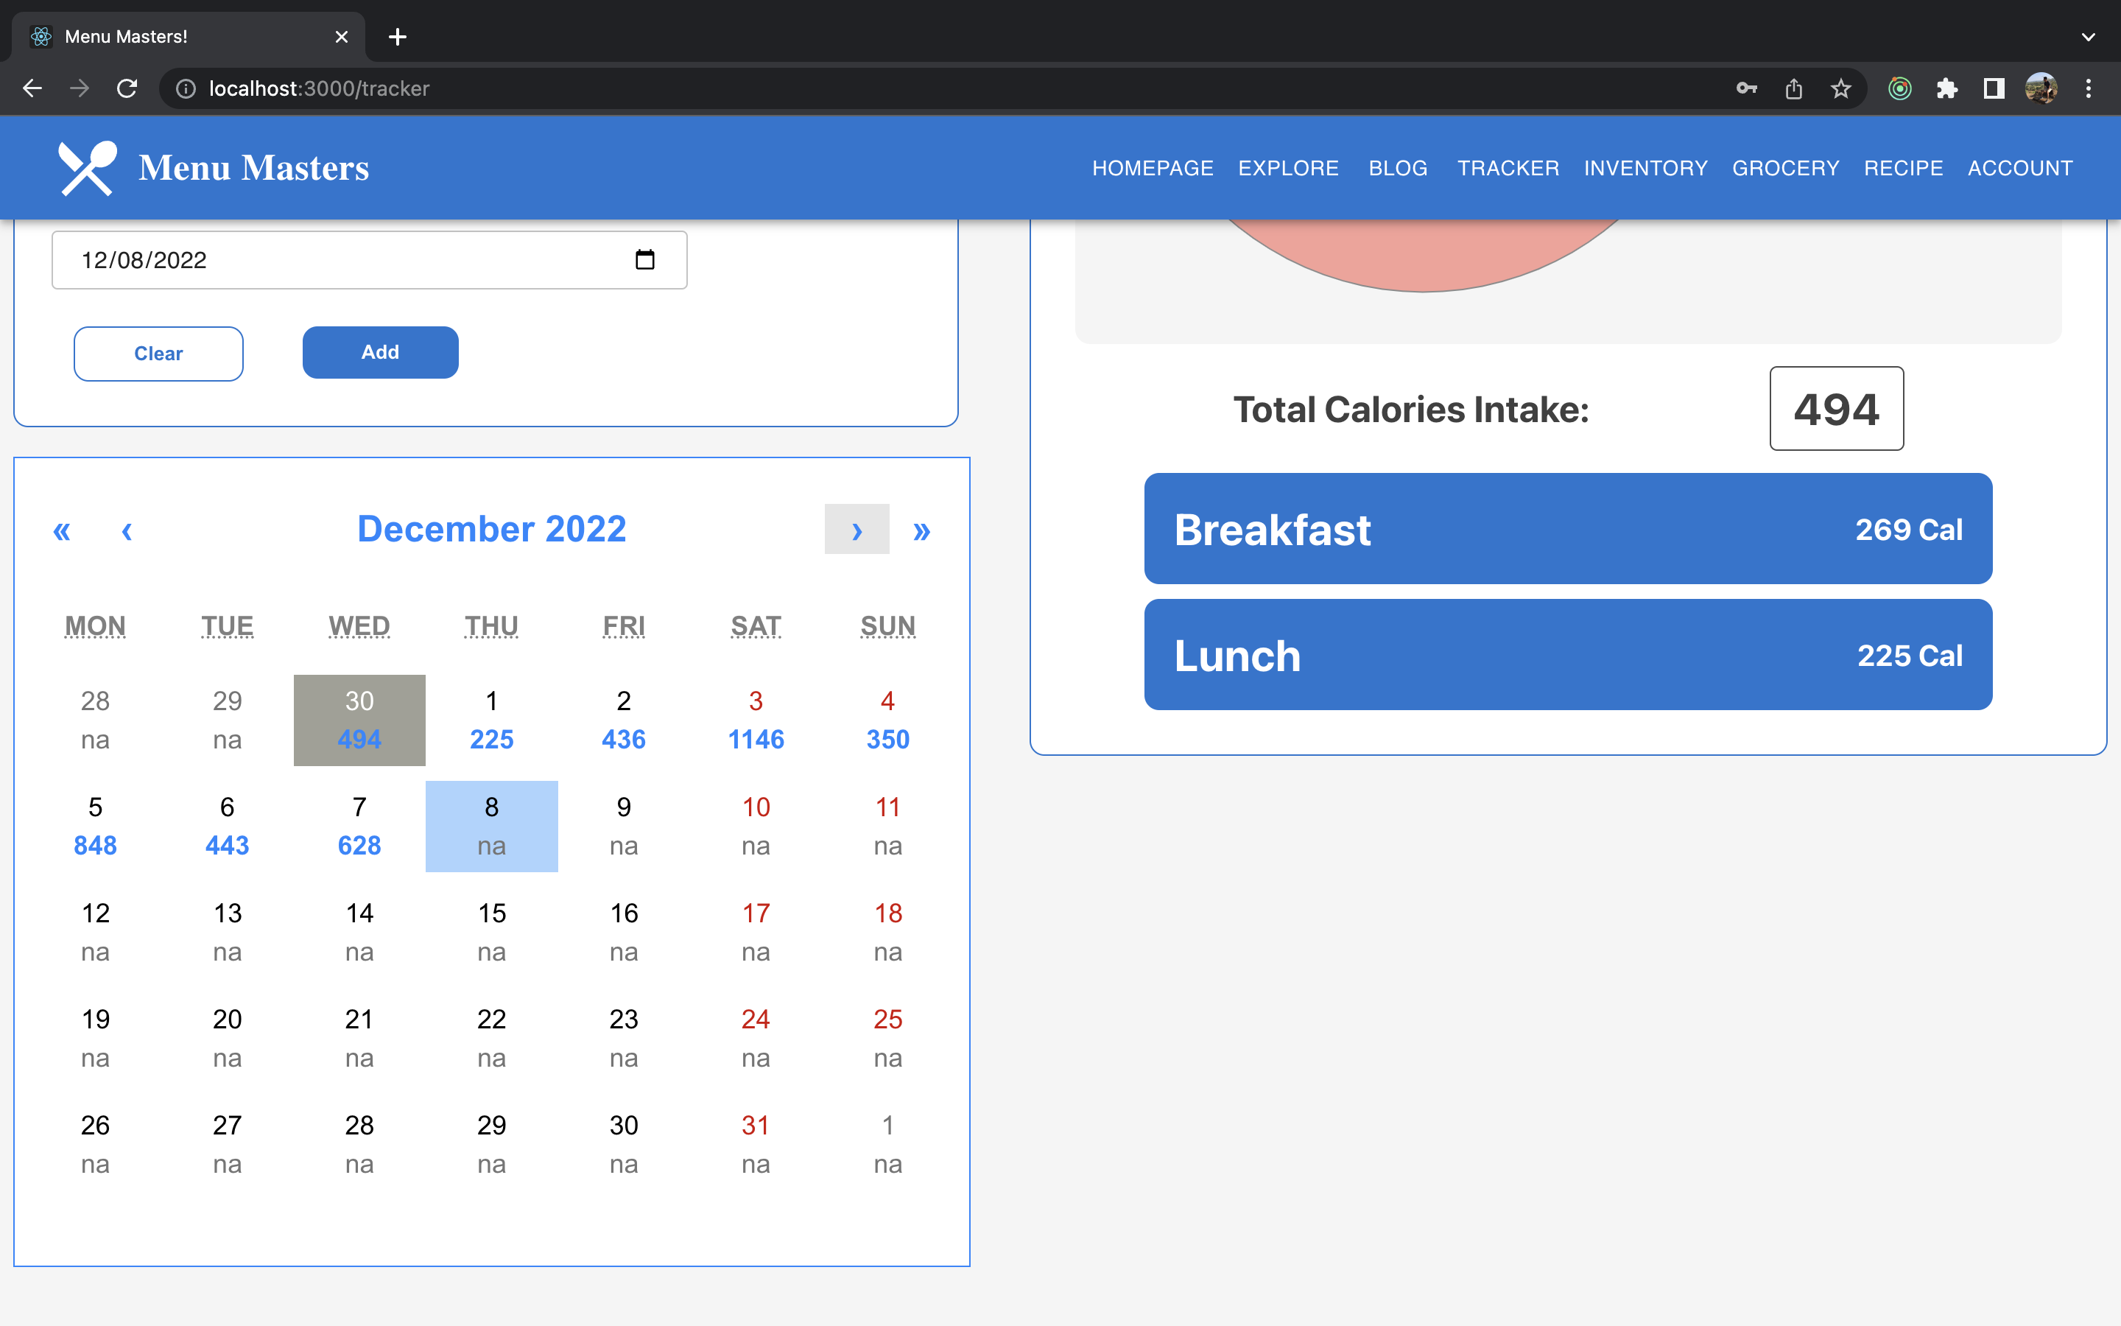
Tracker

Slide 13
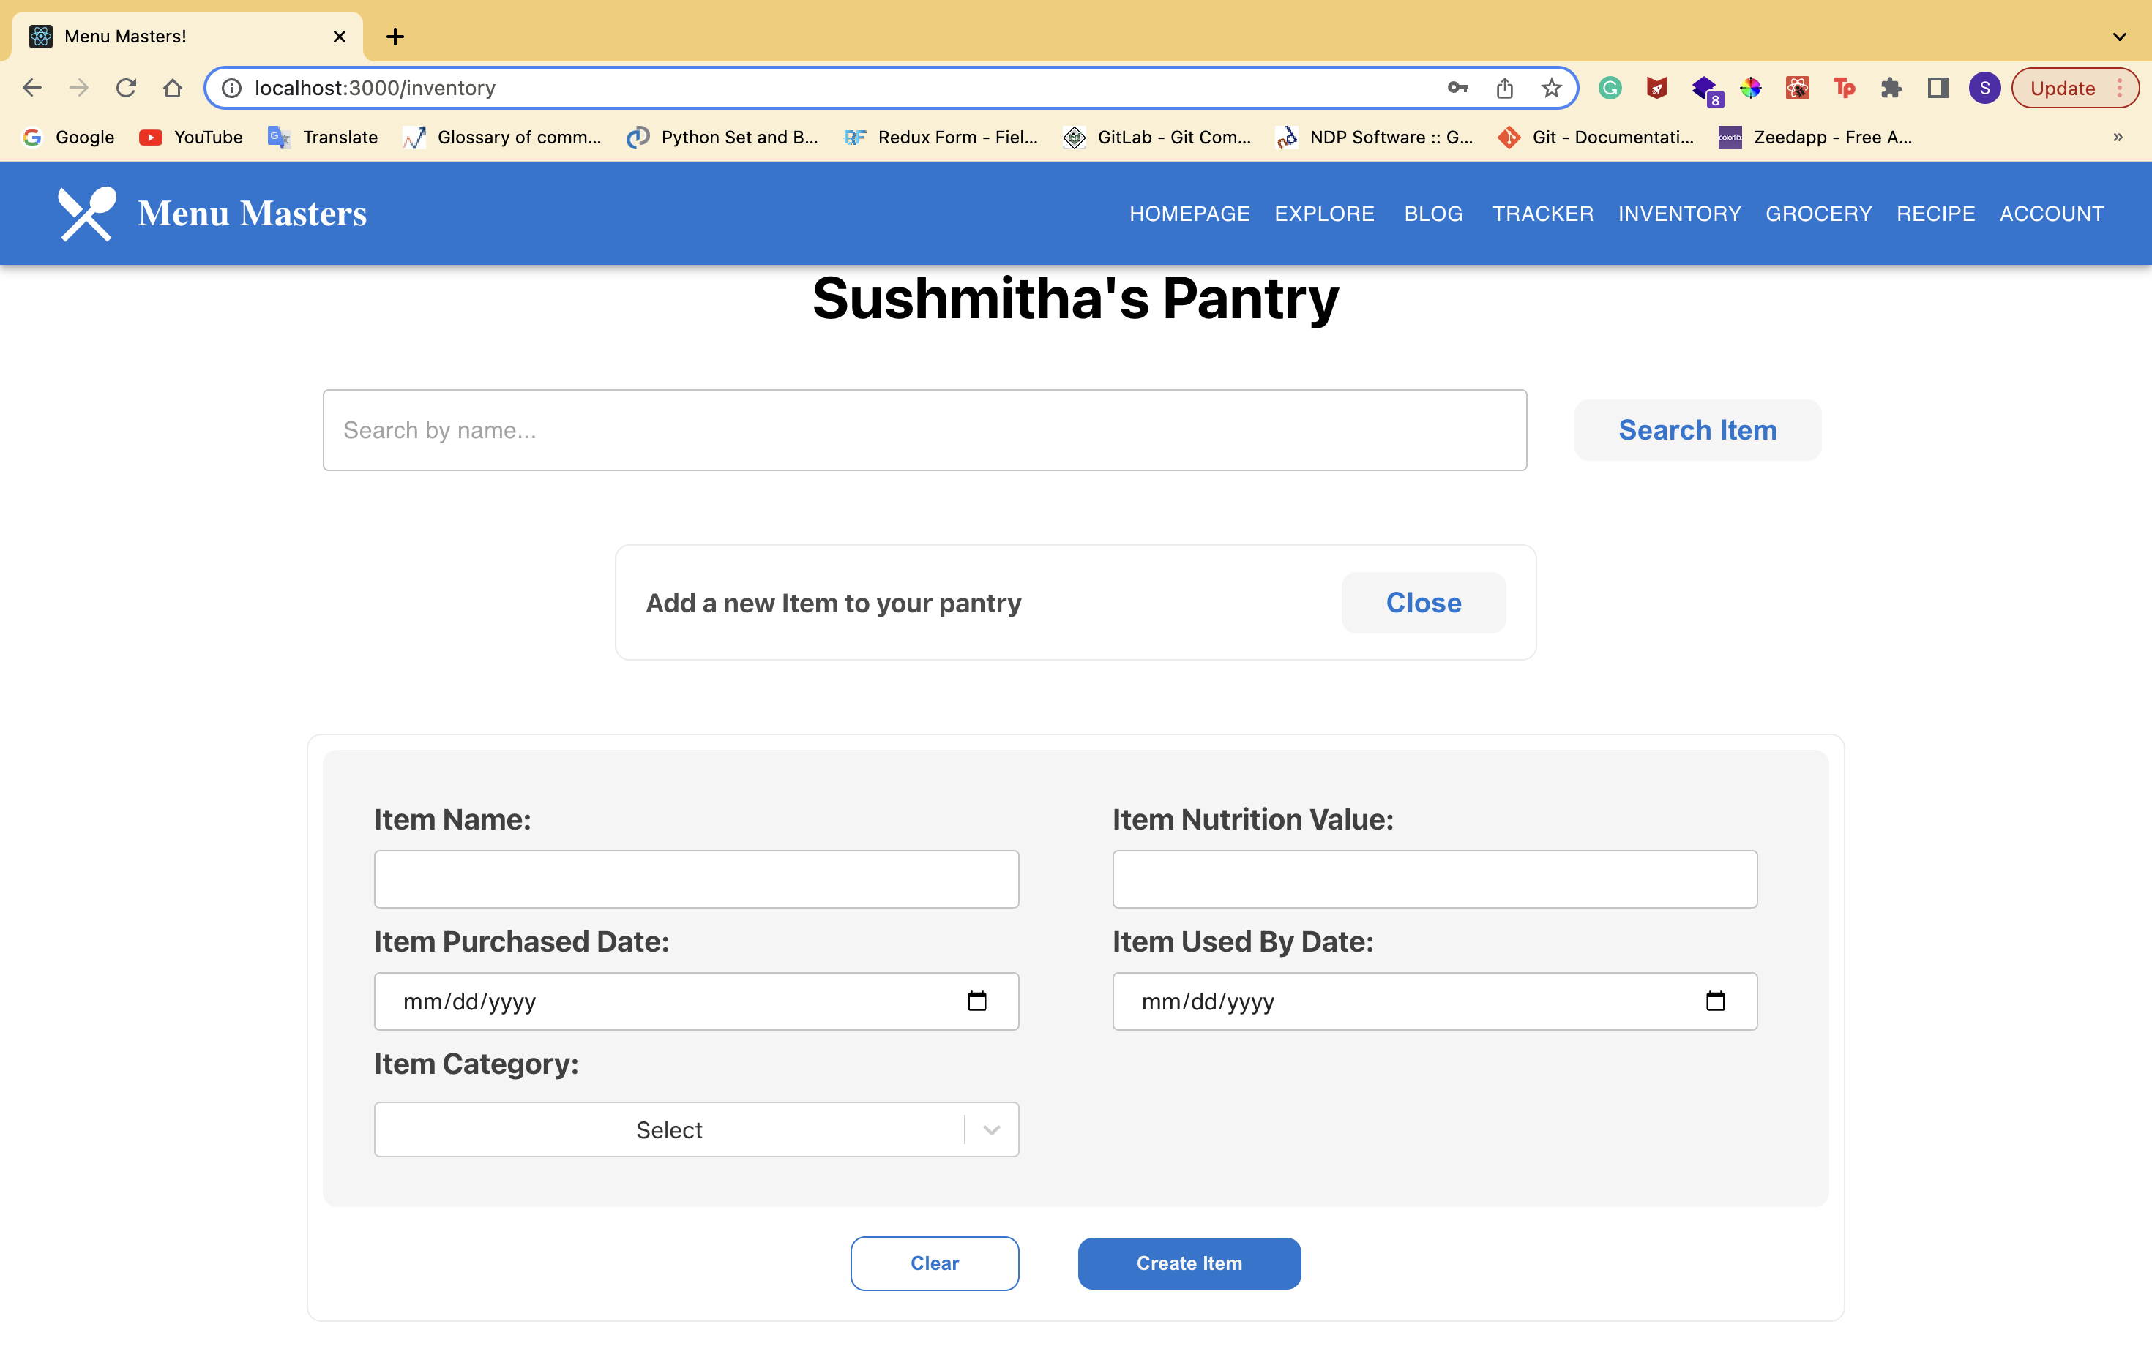
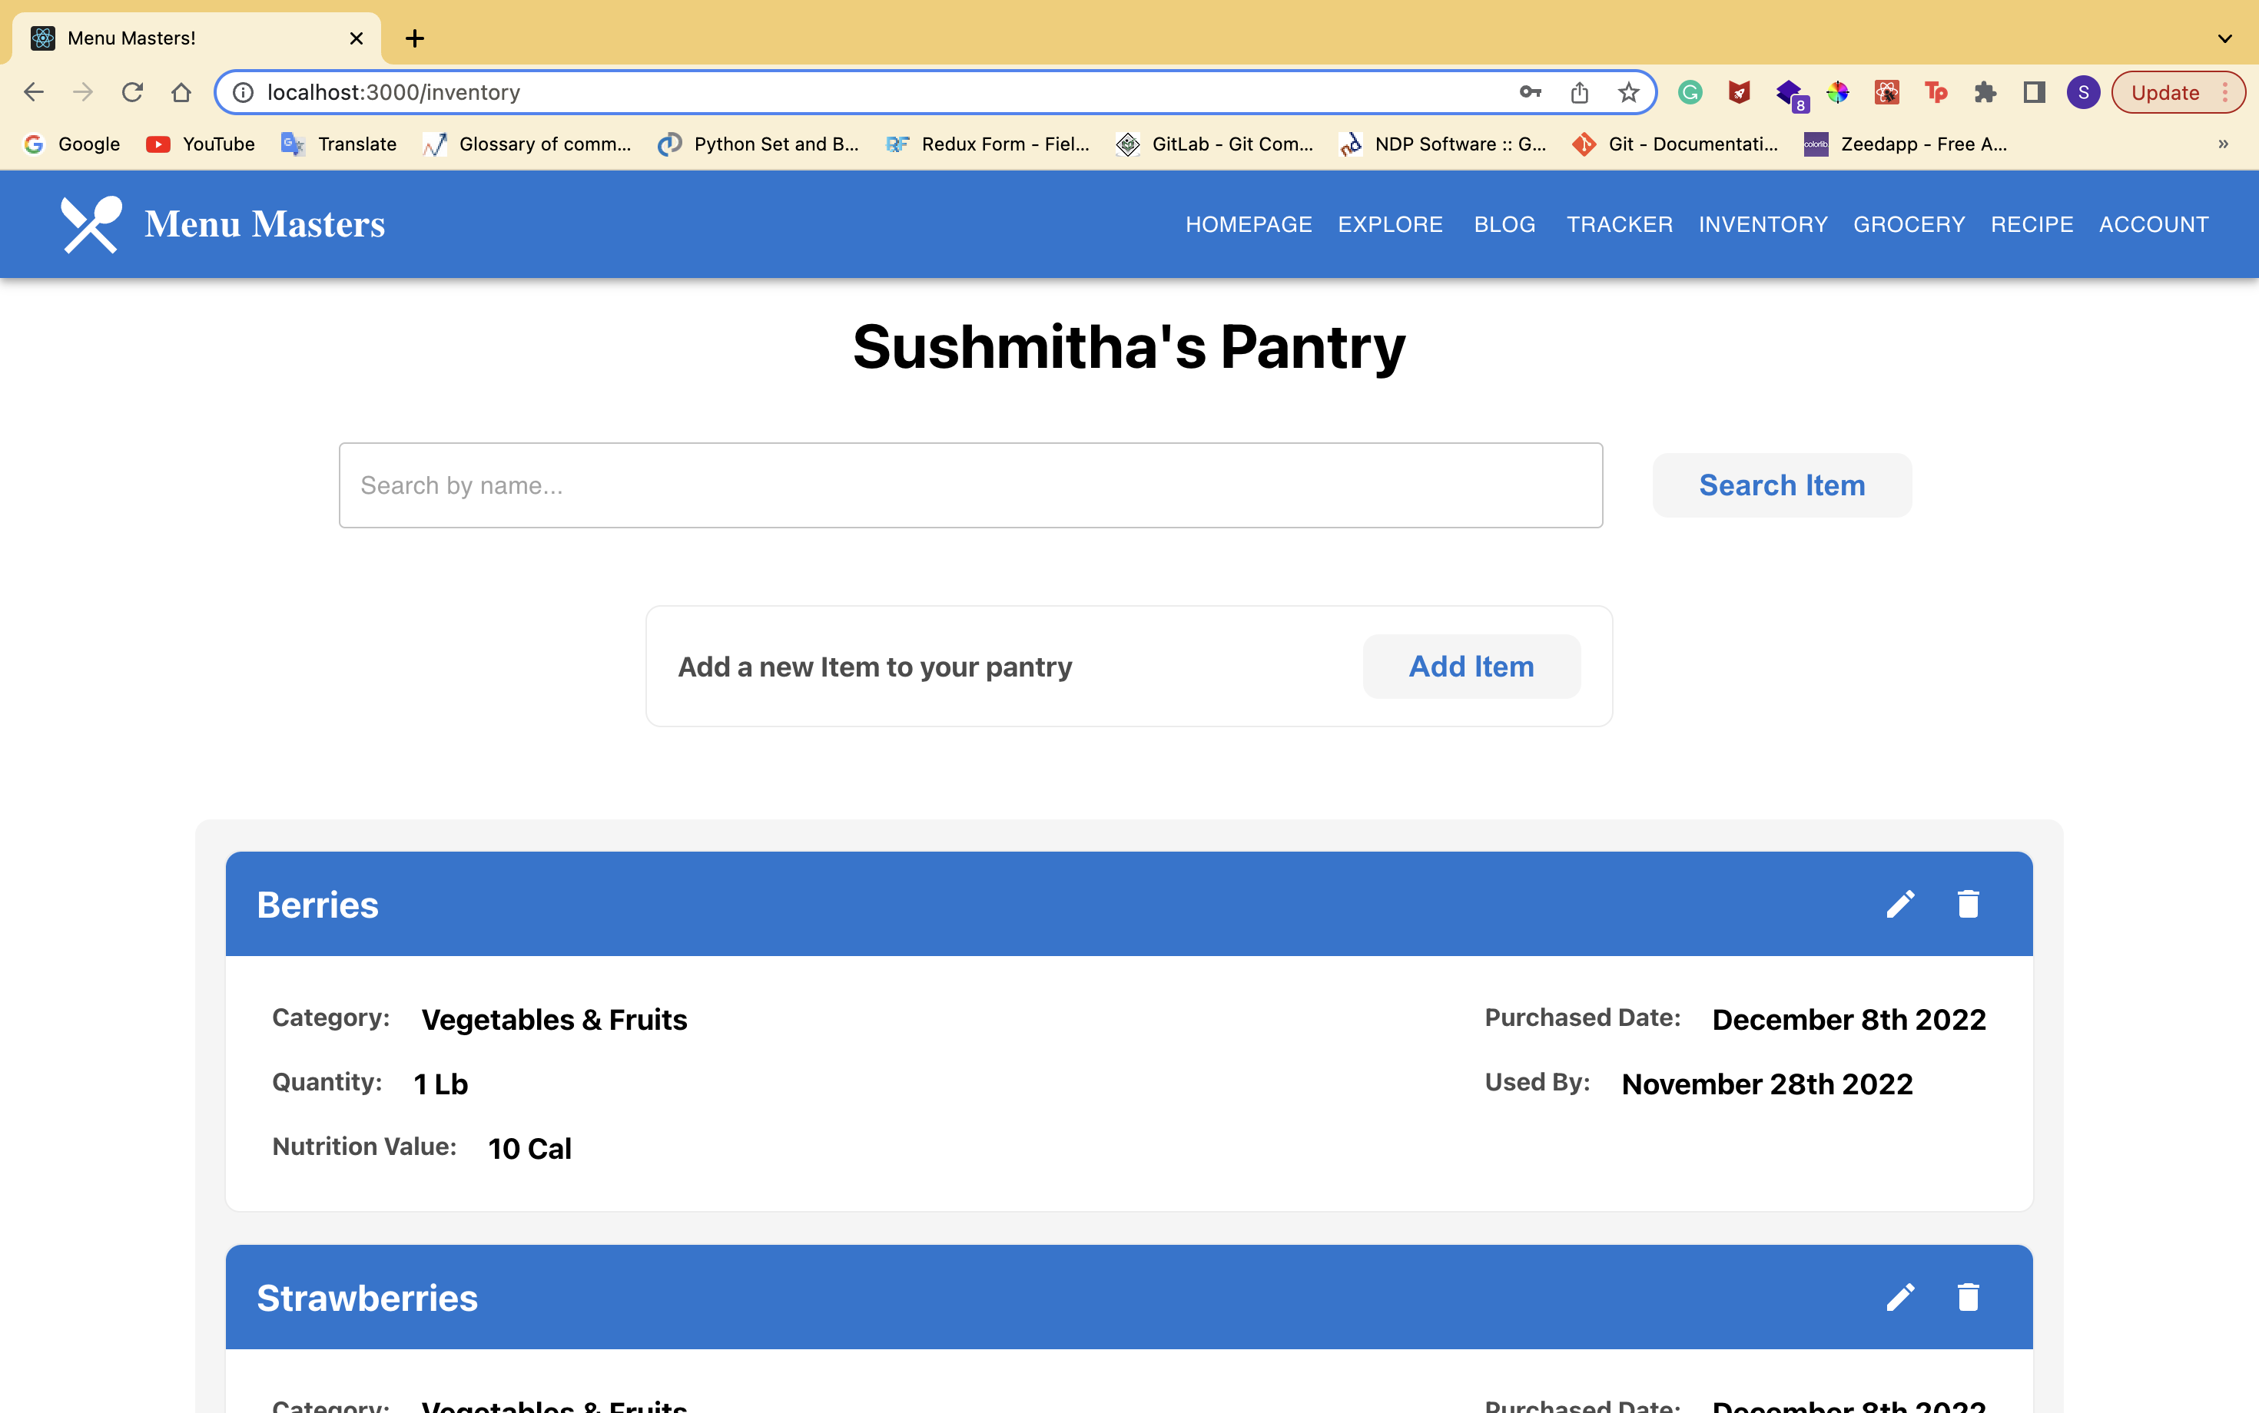
Inventory

Slide 14
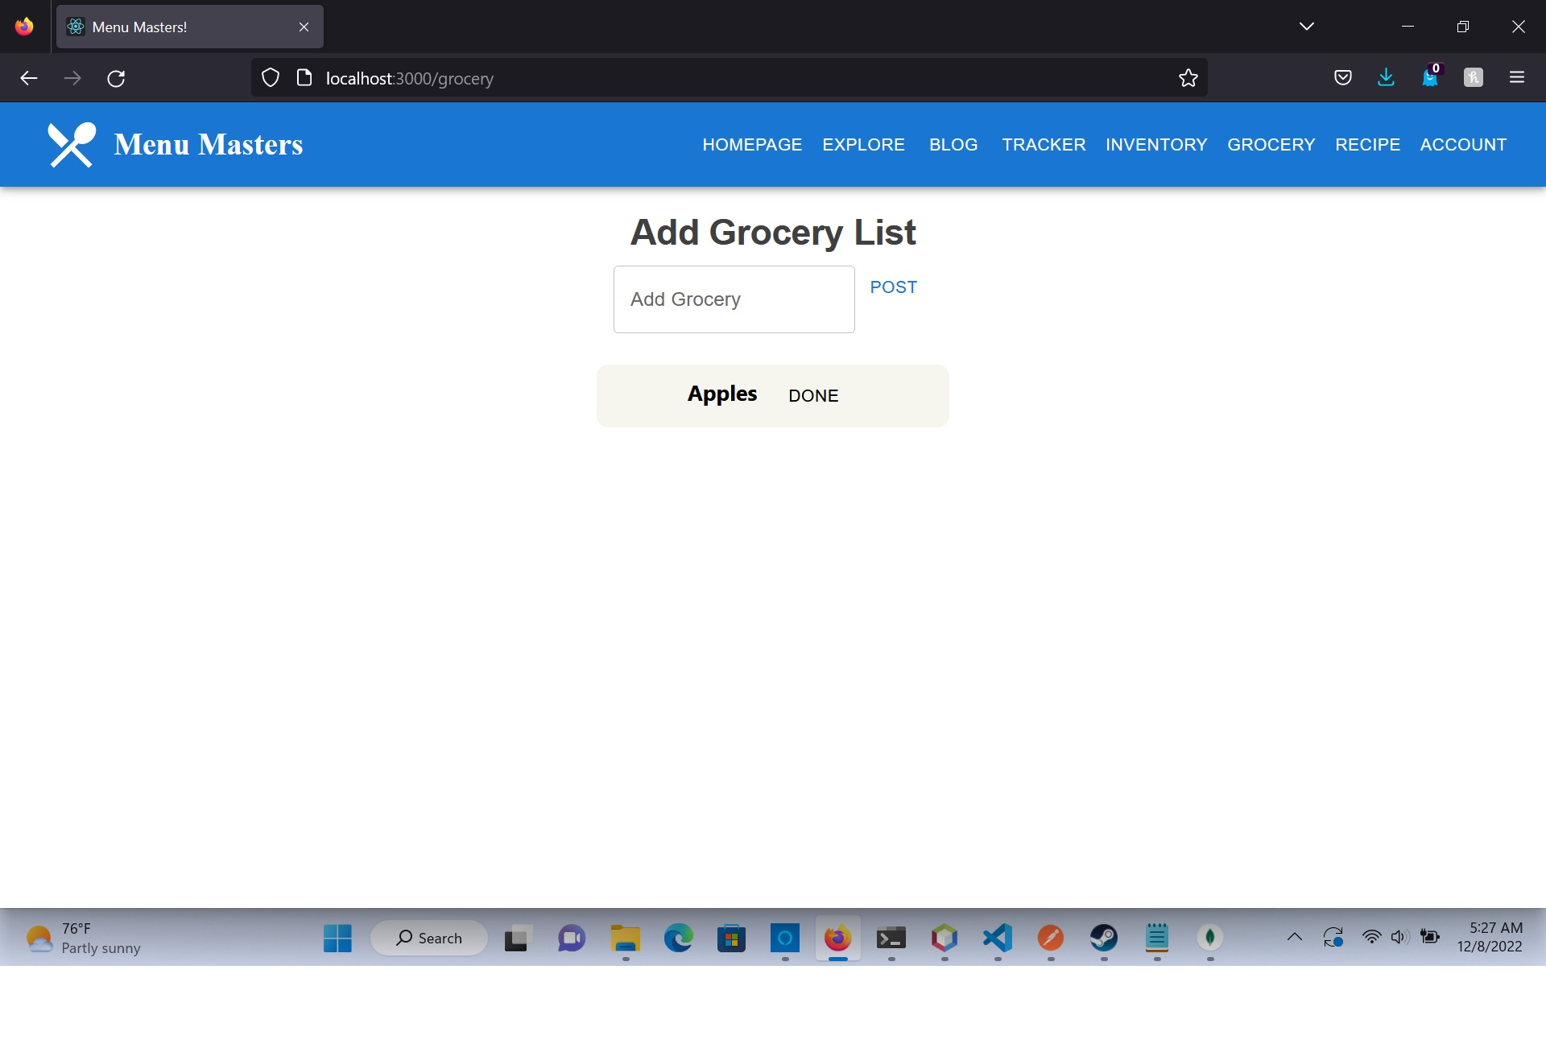
Grocery List

Slide 15
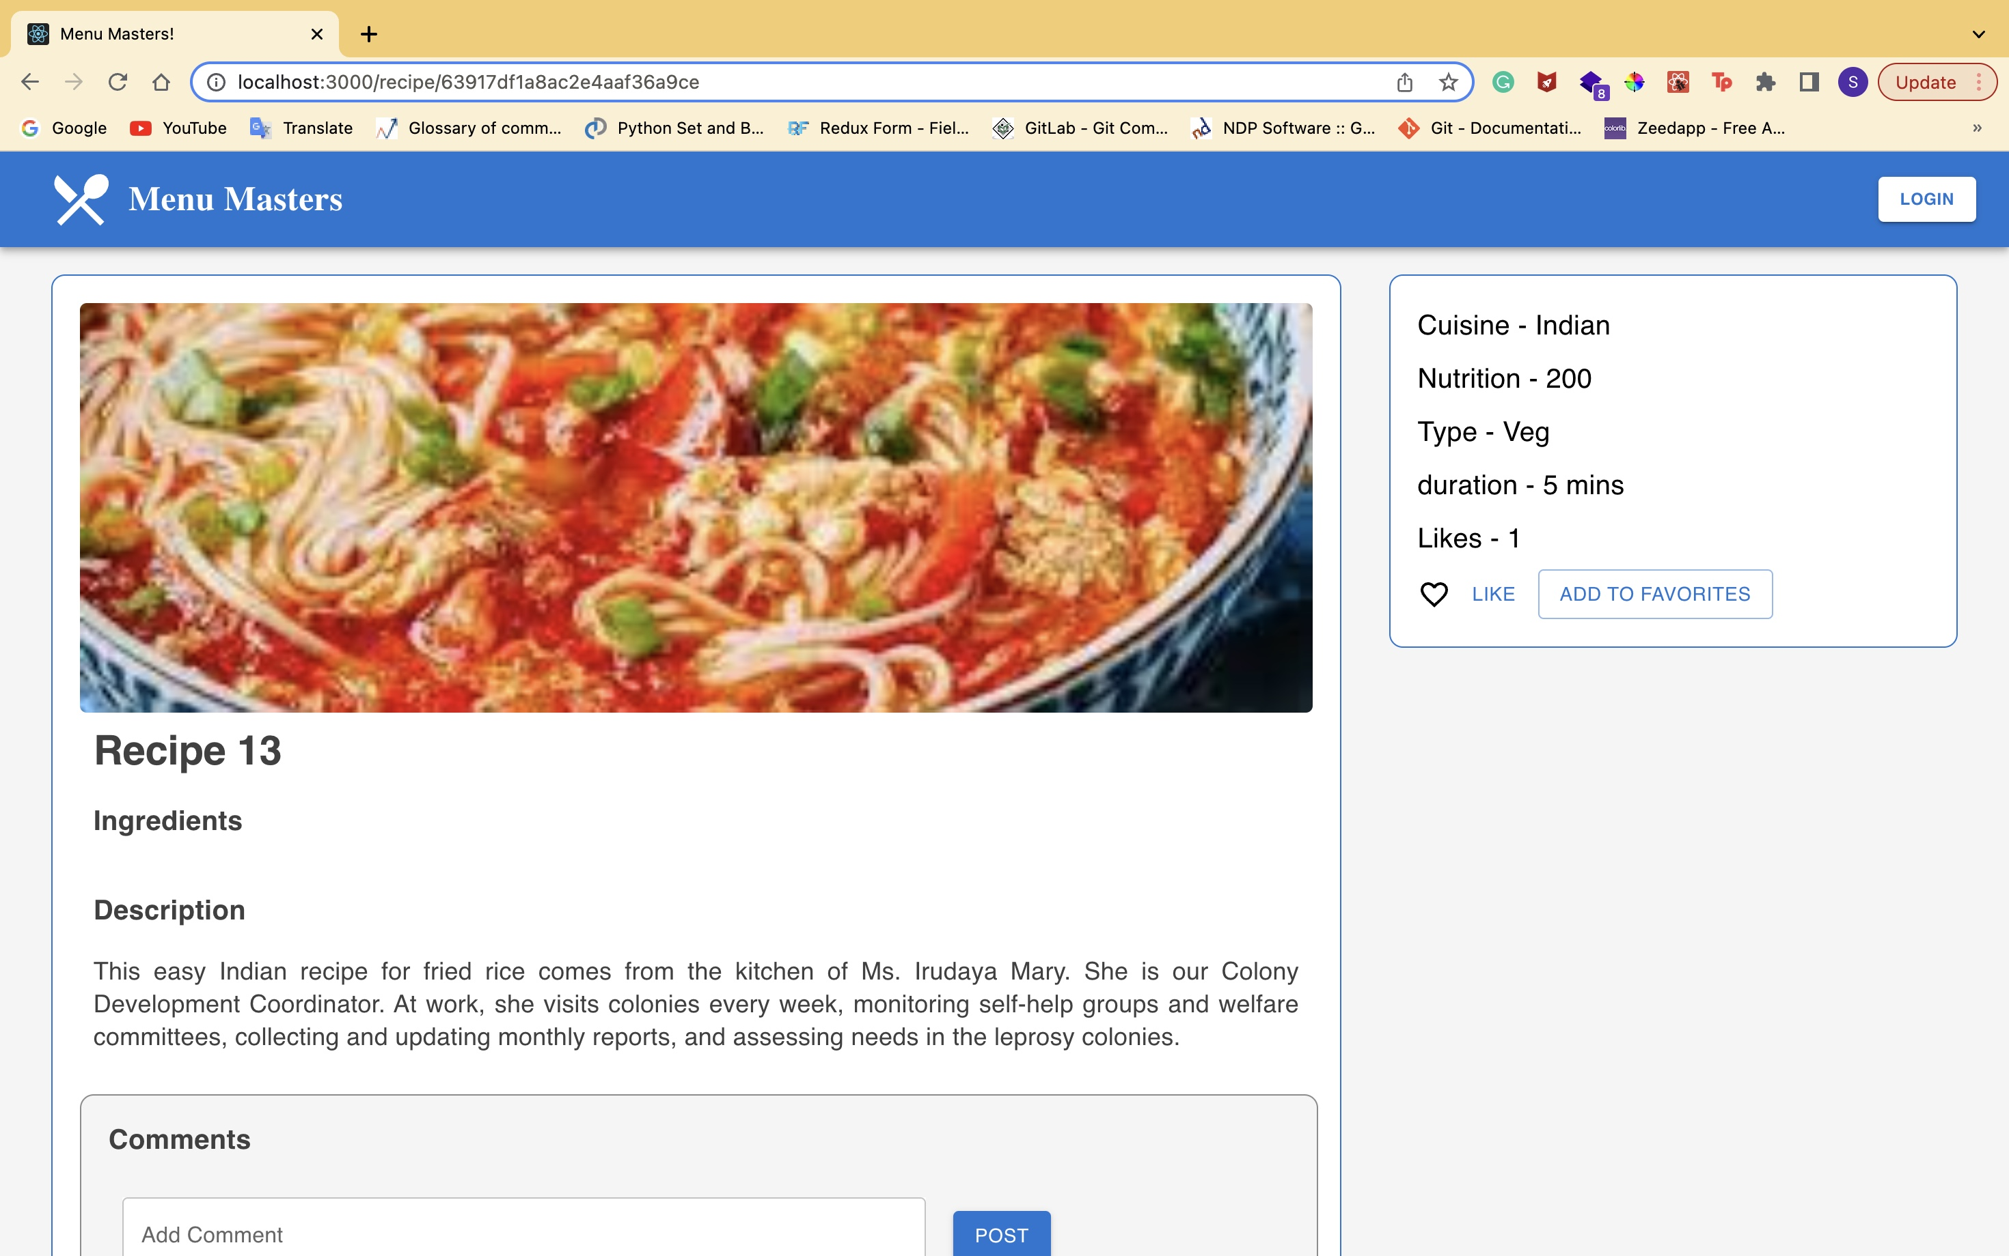
Recipe

Slide 16
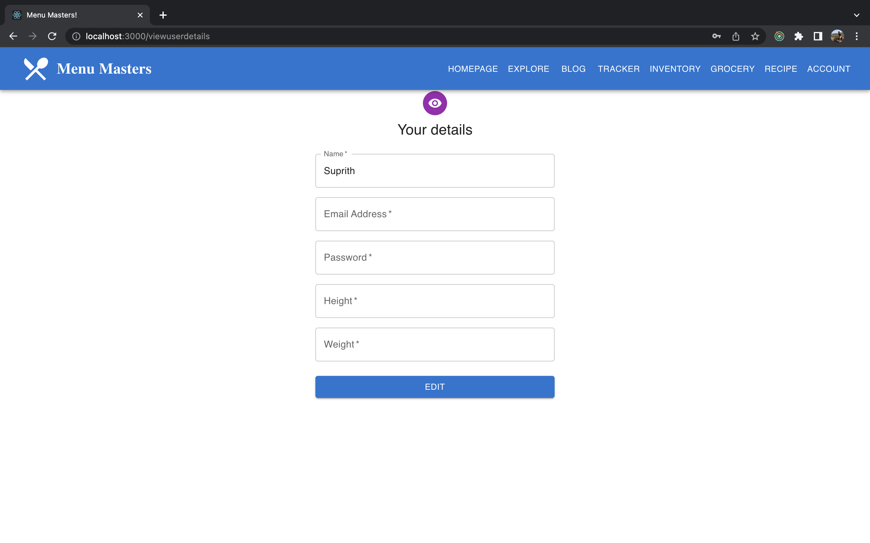
Profile Details

Slide 17

Thank you

